Slide 1









Sport Products Sales Data Analysis
Presenters
Ahmed Osama
Hassan Reda
Mohamed El Dardiri
Mustafa Maher
Mohab Mohamed
Mohamed Mostafa

Slide 2

Agenda
Introduction and Project Objectives
Dataset Overview and Data Analysis Process
Visualizations and Dashboards

Slide 3


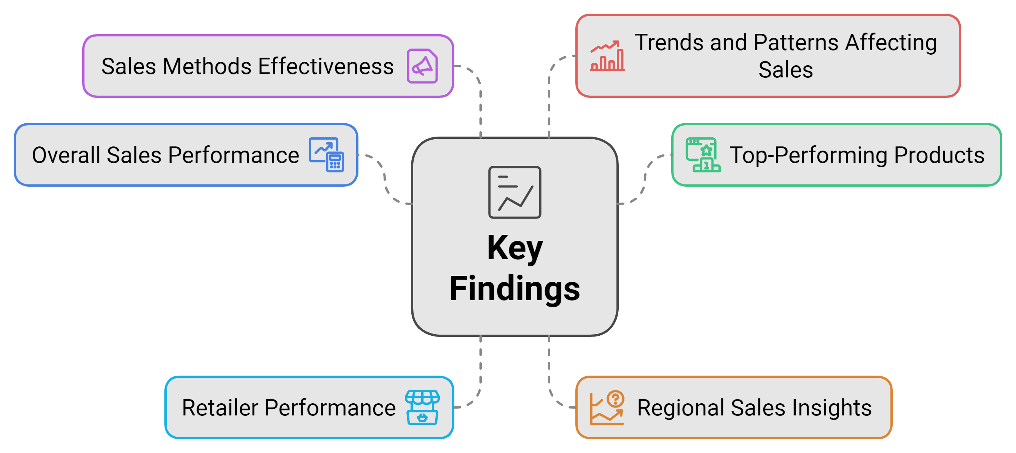
Introduction
Purpose
Comprehensive sales data analysis by utilizing Microsoft Power BI to thoroughly analyze our sales data and aim to transform raw data into meaningful insights.

Slide 4

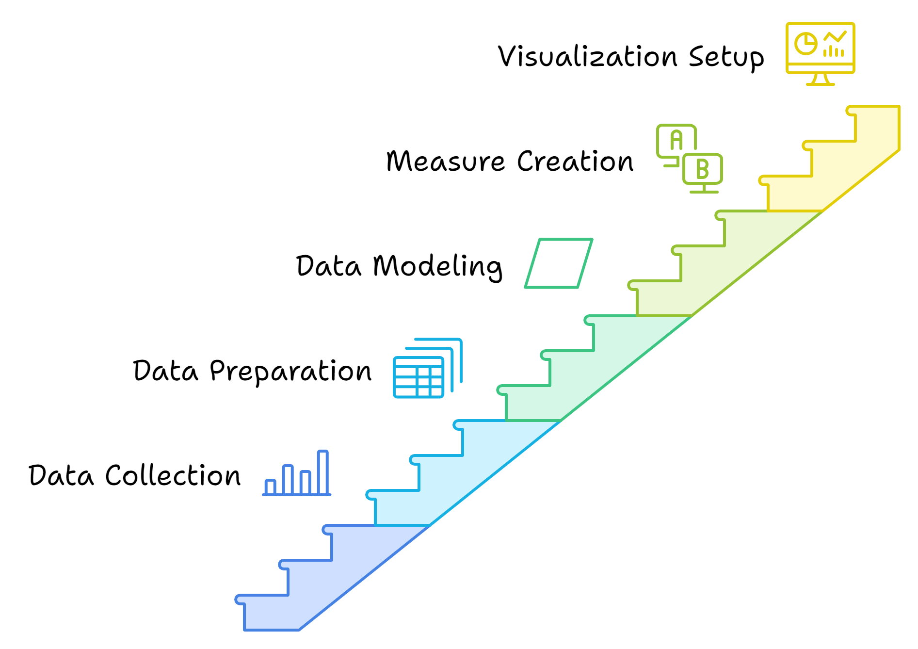
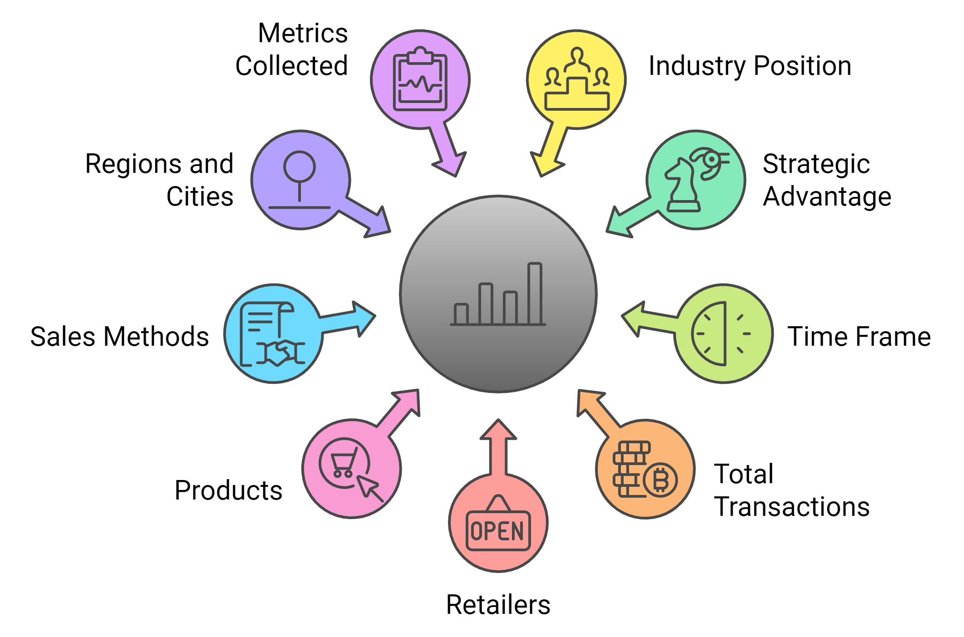
Dataset Overview
Dataset Description
Data Analysis Process

Slide 5
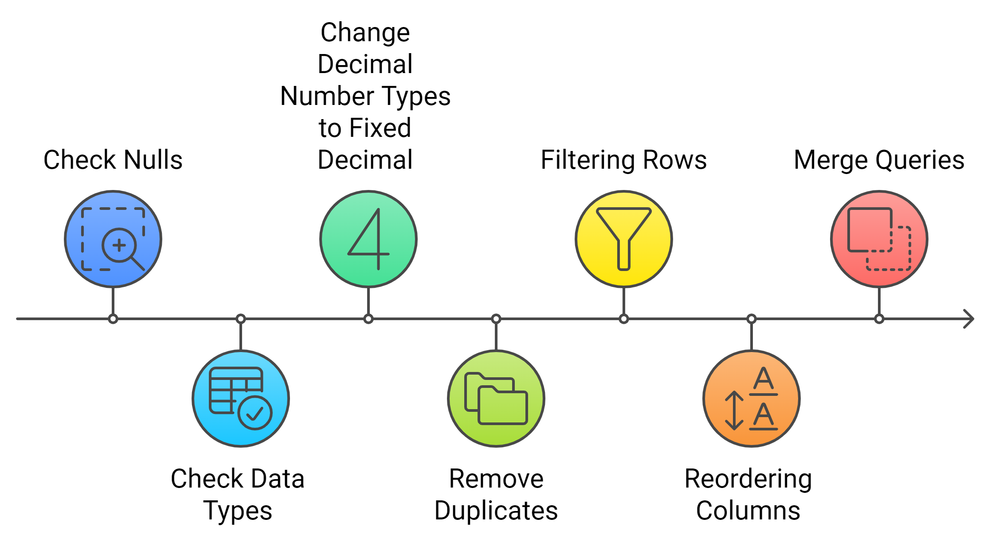
Data Transforming

Slide 6
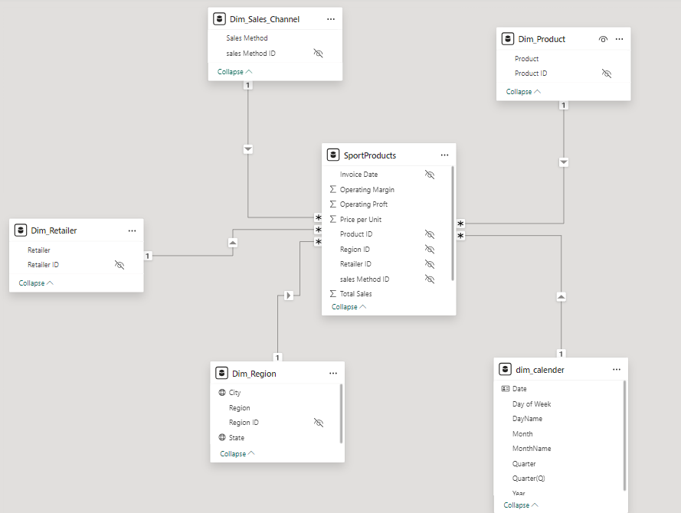

Data Modeling
We created 5 dimension tables to enhance the performance by establishing a star schema.

Slide 7
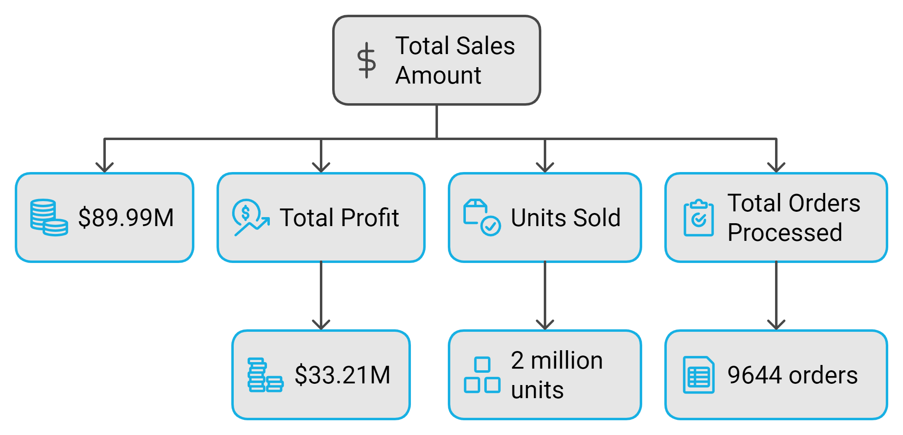
What are the total sales, profit, units sold, and total orders processed during the selected time period?

Slide 8
Product Sales Performance Overview
“
”

Slide 9
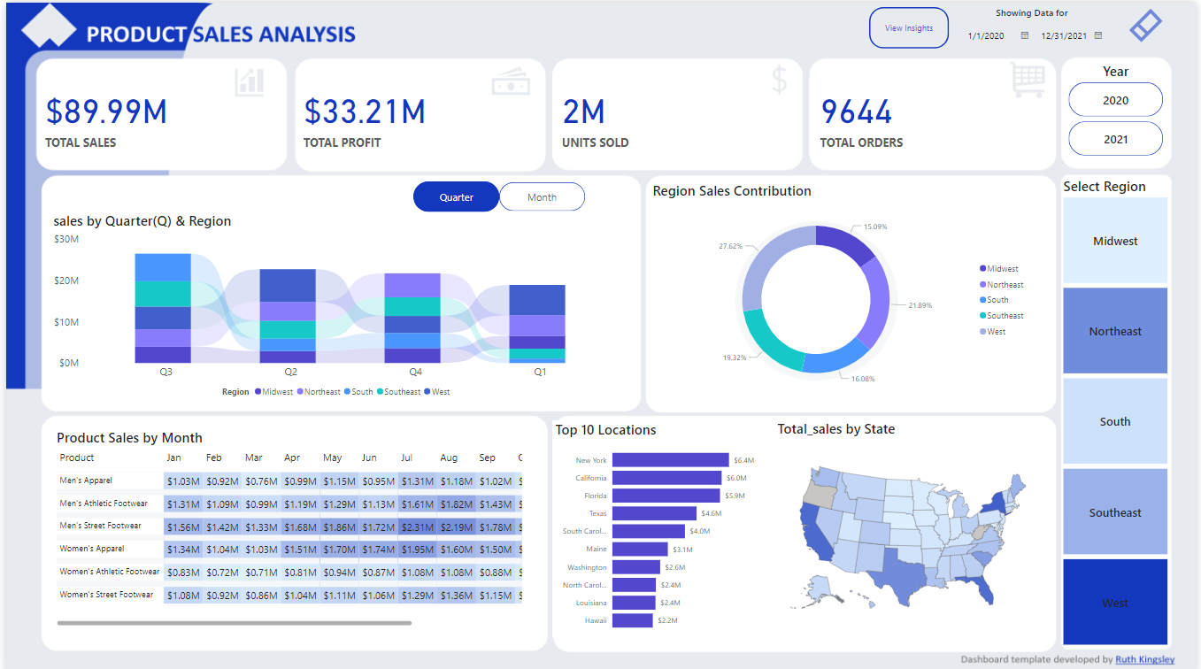

Slide 10
Product Sales & Performance
“
”

Slide 11
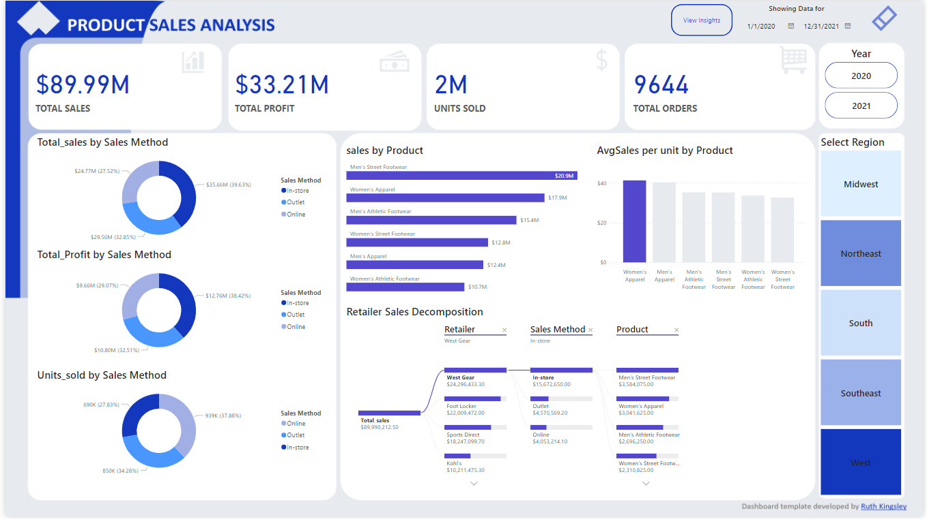

Slide 12
Findings Analysis
“
”

Slide 13
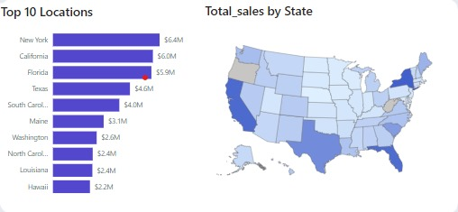
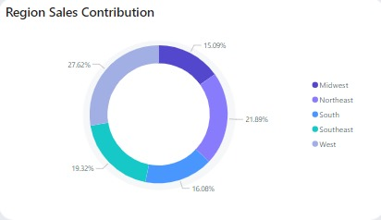
The chart provides a visual representation of the top 10 states in terms of total sales.
Top-selling states:
New York is the clear leader with total sales of $6.4 million.
California and Florida follow closely behind with sales of $6.0 million and $5.9 million, respectively.
Texas, South Carolina, Maine, Washington, North Carolina, Louisiana, and Hawaii round out the top 10 with sales ranging from $4.6 million to $2.2 million.
Sales distribution:
The sales are concentrated in the eastern and western regions of the United States.
The central and southern regions have lower overall sales compared to the east and west.
Geographic patterns:
New York and California have the highest sales, which may be attributed to their large populations and economic activity.
Florida's high sales could be due to its tourism industry and large retiree population.
Texas's sales may be driven by its energy sector and large population.

Slide 14
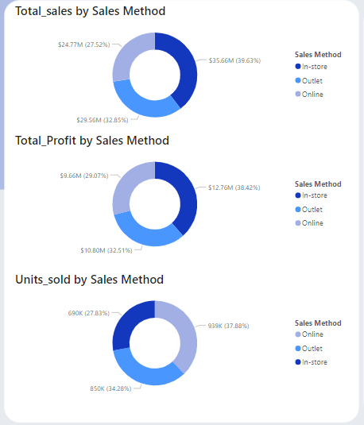
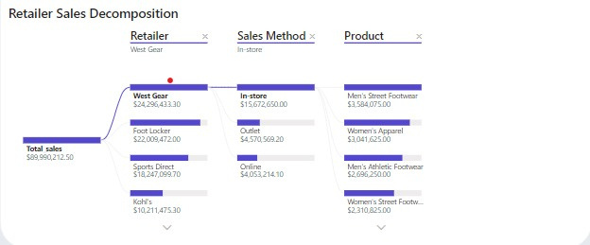
Retailer Performance:
West Gear is the top-performing retailer with total sales of $24,296,433.30.
Foot Locker and Sports Direct follow with sales of $22,009,472.00 and $18,247,099.70, respectively.
Kohl's has the lowest sales at $10,211,475.30.
Sales Method Performance:
In-store is the dominant sales method, contributing to the sales of West Gear.
Outlet is used by Foot Locker and contributes to their sales.
Online is the sales method for Sports Direct.
Product Category Performance:
Men's Street Footwear is the top-selling product category, contributing to the sales of West Gear.
Women's Apparel and Women's Street Footwear also have significant sales.
Men's Athletic Footwear has the lowest sales among the analyzed products.
Sales Performance: In-store is the top sales method (39.63%), followed by Outlet (32.85%) and Online (27.52%). Outlet and
In-store channels drive the majority of sales.
Profit Distribution: In-store leads in profit contribution (38.42%), with Outlet at 32.51% and Online at 29.07%. While In-store is most profitable Outlet’s profit percentage is close.
Units Sold : Online leads in units sold with (37.88%), and outlet comes second with (34.28%) and surprisingly in-store is the least amount of units sold with (27.83%) although it’s the most profitable method.

Slide 15
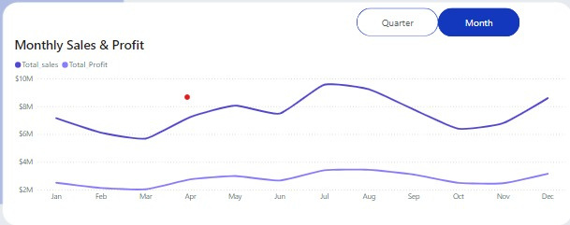
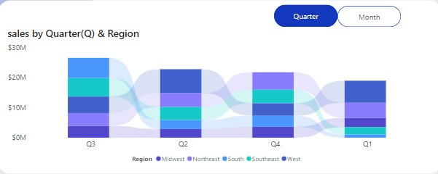
The chart indicates a strong correlation between sales and profit.
The business experienced significant growth from April to July.
The slight decline in sales and profit from August to October may be due to seasonal factors or other external influences.
The rebound in sales and profit in November and December suggests that the business is recovering from any temporary setbacks.
Regional sales:
The west region has the highest sales in all quarters.
The Northeast region has the second-highest sales in all quarters.
The South, Southeast, and the Midwest regions have relatively similar sales levels across all quarters.
Quarter-over-quarter trends:
Sales in the South region increased from Q1 to Q3 and then declined in Q4.
Sales in the Southeast region increased from Q1 to Q2 and then remained relatively stable in Q3 and Q4.
Sales in the Midwest , Northeast, and West regions fluctuated throughout the year, with no clear trends.

Slide 16
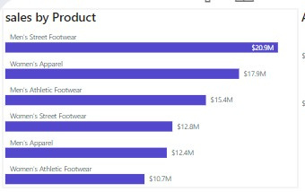
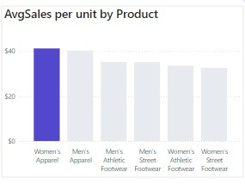
Sales distribution:
- Women's Apparel have slightly higher average sales per unit than Men's Apparel .
- The average sales per unit for the other product categories are relatively similar, ranging from $30 to $35.
Product performance:
- Women's Apparel stands out as the product category with the highest average sales per unit, indicating that it is priced higher or has a higher perceived value Although, Men's Street Footwear have the highest sales, indicating strong demand for this category .
- The other product categories have relatively similar average sales per unit, suggesting that pricing and value perception may be comparable.

Slide 17
RECOMENDATIONS
“
”

Slide 18
The overall gap between Q3 and Q1
California in Q1
New York in Q1
Women's apparel PPU
Texas, South: an annual sports event
Florida, Southeast: summers in Miami (the Caribbean-like feel), beach life and nightlife, shopping
California in Jan: whale watching, kayaking enthusiasts
New York in Q1: starting in December, thriving in Jan, winter activities & sports
a record-high average of approx. USD 42, representing the pink tax.

Slide 19

Thank you

